Slide 1

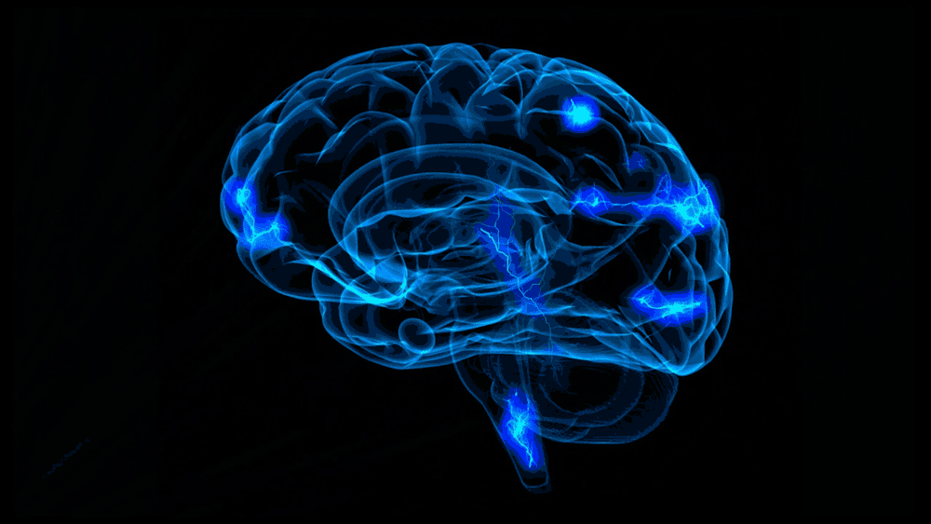
Defense-CSE400
Deep-learning Based Emotion Recognition Using EEG Signal
Supervised By
Tanmoy Sarkar Pias
Lecturer
Department of CSE
University of Asia Pacafic
Presented By
Samina Yasmin-17101113
Mahmudul Hasan-17101120
Rokhshana-Nishat-Anzum-17101137

Slide 2

Contents
Introduction
2. Overview
3. Problem of Existing Research
4. Research Statement
5. Related Work
6. Materials and Methods
i) Synopsis of DEAP Dataset
ii) Preprocessing
iii) Feature Extraction
iv) Signal Decomposition
v) Proposed Classification Approach
7. Experiment in Details
8. Result Analysis
9. Contribution
10. Application
11. Future Plan

Slide 3
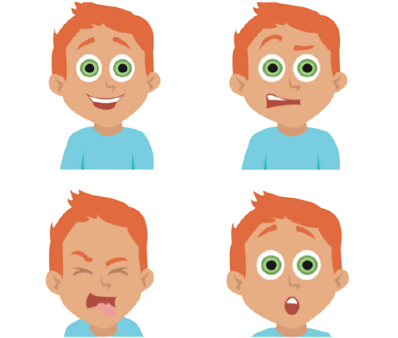
Introduction
What is deep-learning based emotion recognition using EEG signals?
It is a process by which human emotions can be recognized
using the EEG signals (brain signals) with the help of deep
learning.
Why do we need this?
Find out mental condition.
To detect psychological disorder.
To improve the Human-Computer interaction technology.

Slide 4
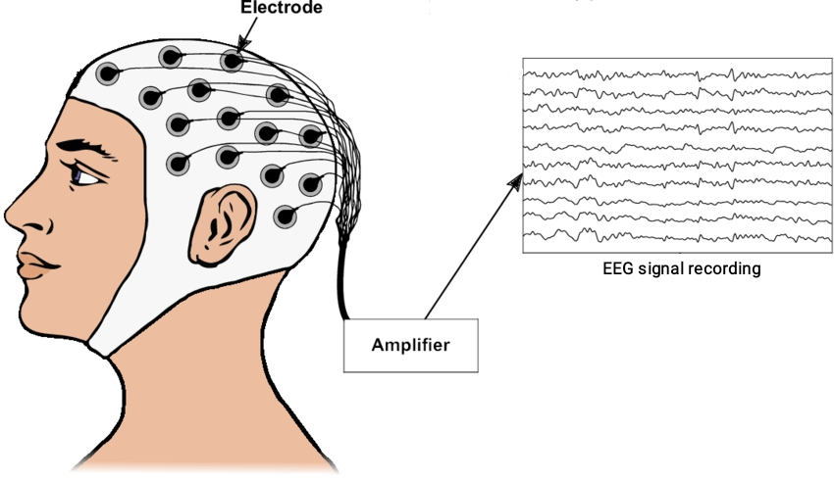
Overview
What is EEG signals?
The brain's electrical activity
How the EEG signals are collected?
EEG electrodes that are placed on the scalp

Slide 5
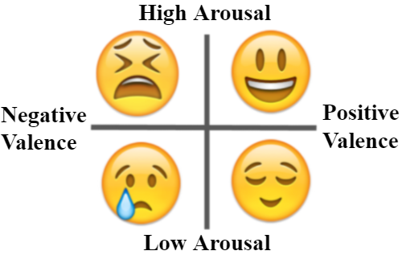
Emotion Dimension
Emotional experiences can be described in two terms:
Valence
Arousal
What is Arousal and Valence?

Slide 6
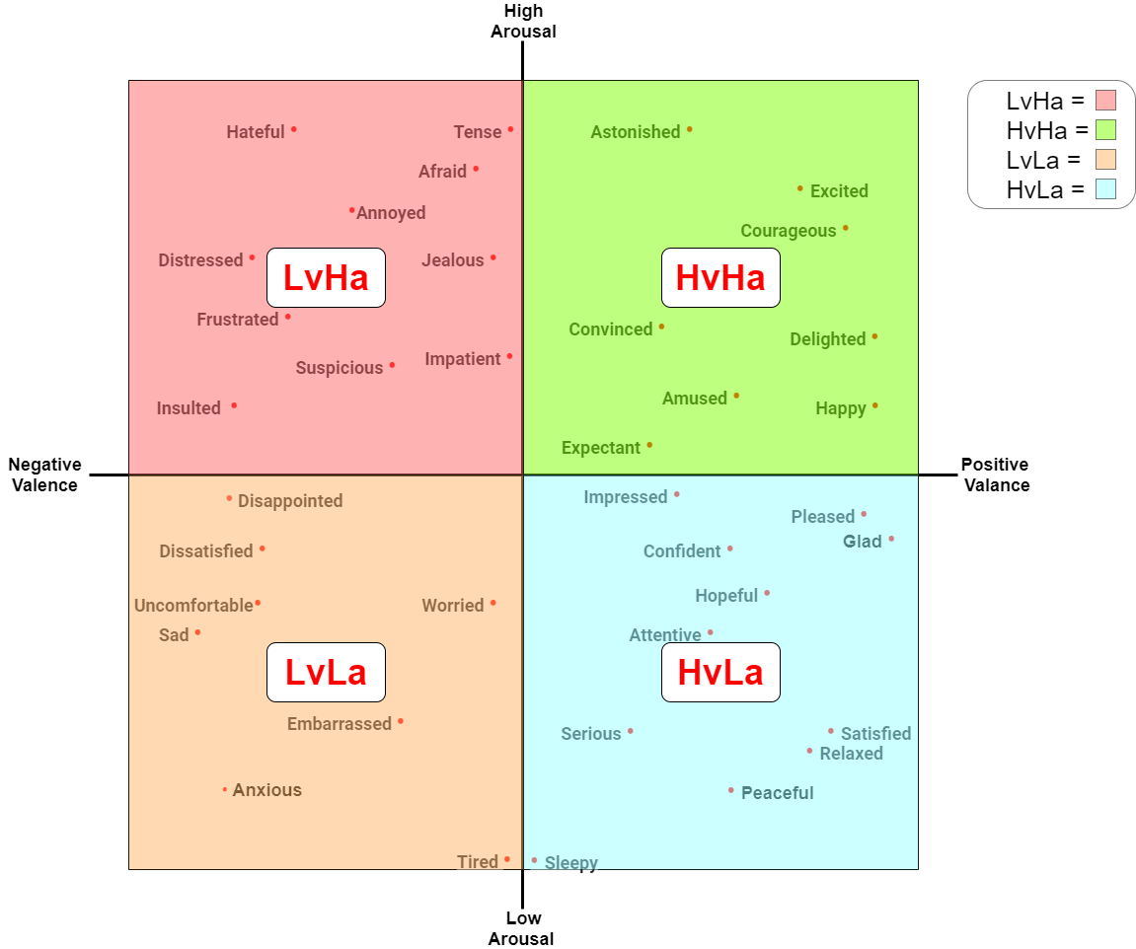
Problem of Existing Research
Conventional approach is able to recognise only 4 emotions precisely.
There is scope to increase the accuracy of classification from 92.5%.

Slide 7
Research Statement
Fine Grained Emotion Recognition from EEG Signal Using Fast Fourier Transformation and CNN

Slide 8
Related Work
No. | Research | Year | Feature Extraction | Modeling Techniche | No. of Class | Working Label | Performance
1. | Divya Acharya Et al. [3] | 2020 | FFT | LSTM | 2-class | Arousal, Valence | 89.83%
2. | Rahul Sharmaa Et al. [4] | 2020 | DWT | LSTM | 2-class | Arousal, Valence | 82.01%
3. | Yucel Cimtay Et al. [15] | 2020 | RAW DATA | CNN | 2-class | Arousal, Valence | 91.5%
4. | Xiaolong Zhong Et al. [14] | 2020 | Down sampling | CNN | 2-class | Arousal, Valence | Arousal:68.50% Valence::66.23%
5. | Guolu Cao Et al. [12] | 2019 | PCA | CNN | 2-class | Arousal, Valence | Arousal:84.3±4.0% Valence:81.2±3.0%

Slide 9
Related Work (cont.)
No. | Research | Year | Feature Extraction | Modeling Techniche | No. of Class | Working Label | Performance
6. | Yucel Cimtay Et al. [11] | 2020 | RAW DATA | CNN | 2-class | Arousal, Valence | 72.81%
7.. | Zhongke Gao Et al. [9] | 2020 | DE | CDCN | 2-class | Arousal, Valence | 92.58%
8. | Yulong Luo Et al. [10] | 2020 | Variance | SNN | 2-class | Arousal, Valence | Arousal:74% Valence:78%
9 | Eman A. Et al. [13] | 2020 | SPD | LERM | 2-class | Arousal, Valence | Arousal:72.6% ± 6.7 Valence: 74.6% ± 3.9
10. | Soheil Rayatdoost Et a1. [1] | 2018 | HOC,PSD, DE, HOS | RF | 2-class | Arousal, Valence | Arousal:91.5% Valence:60.86%

Slide 10
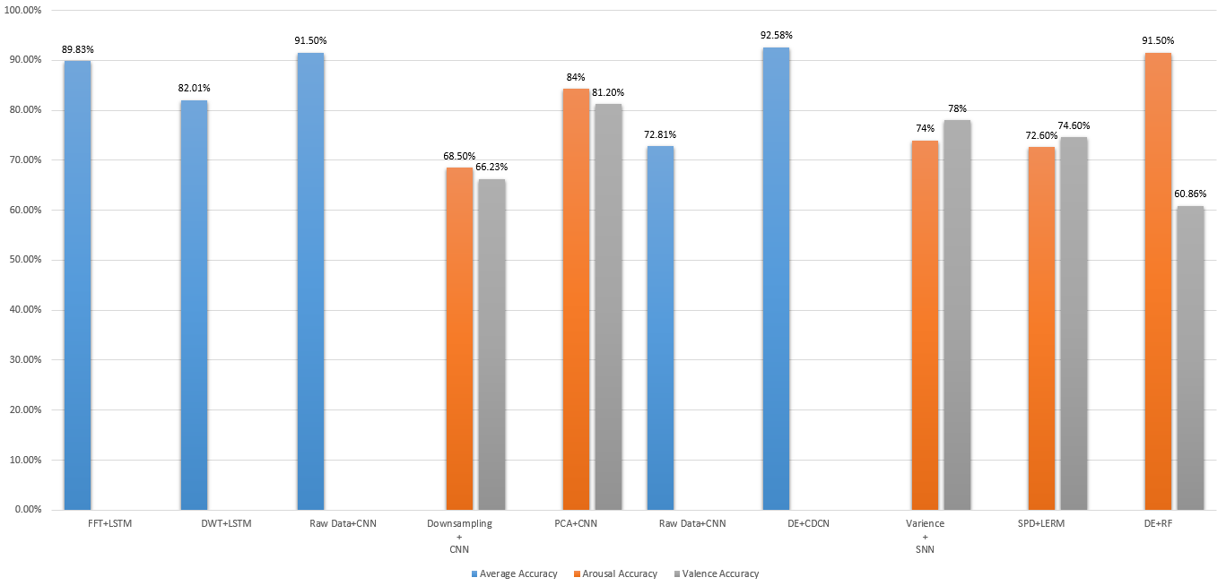
Related Work Accuracy Graph

Slide 11
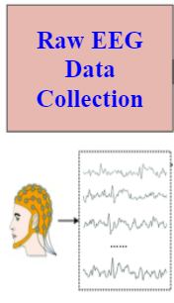
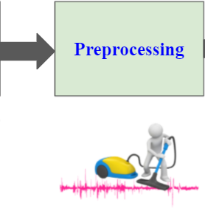
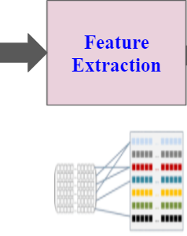
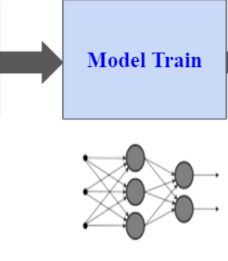
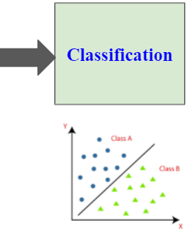
Materials and Methods
Given steps are followed for this analysis:

Slide 12
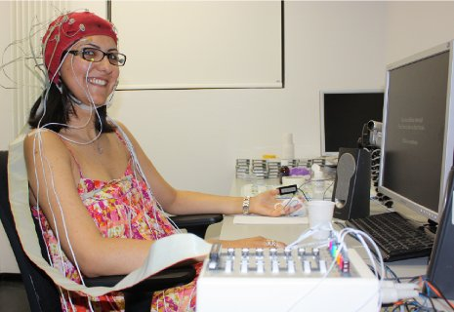
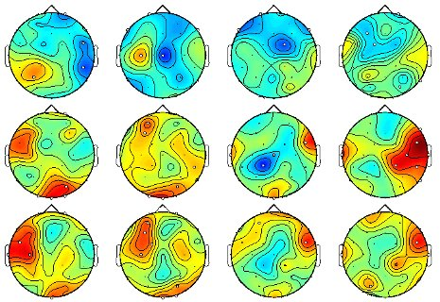
Dataset
We have used publicly available DEAP dataset. DEAP means “A Database for Emotion Analysis using Physiological Signals’’.

Slide 13
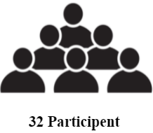
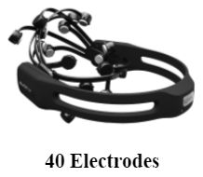
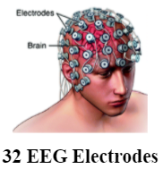
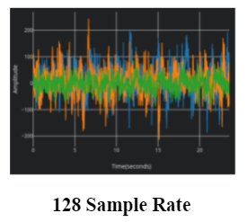


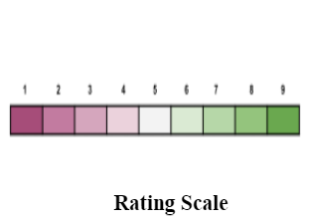
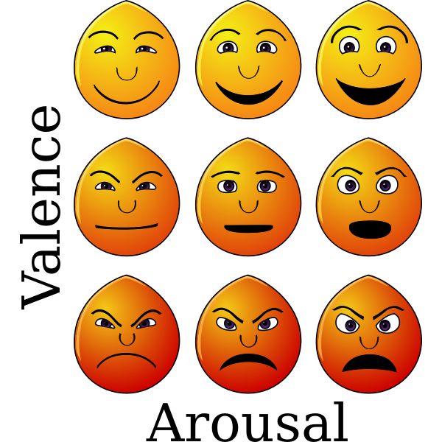
Synopsis of DEAP Dataset

Slide 14
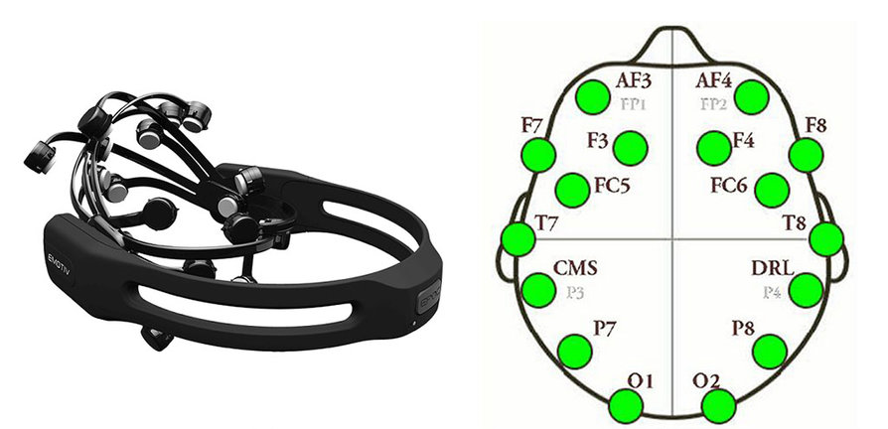
Which electrode data we have used

Slide 15
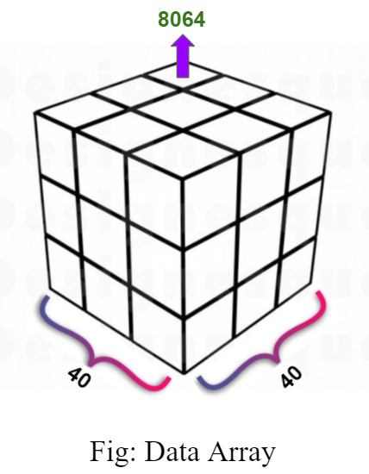
Data Array in DEAP Dataset
Video/trial 40
Channel 40
Data 8064

Slide 16
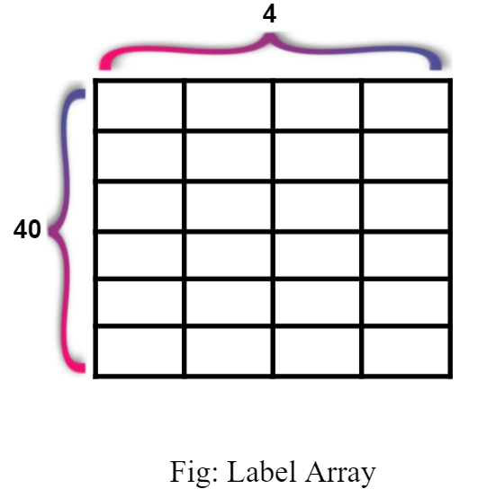
Label Array in DEAP Dataset
Video/trial: 40
Label: 4
Valence: 1-9
Arousal: 1-9
Dominance: 1-9
Liking: 1-9

Slide 17
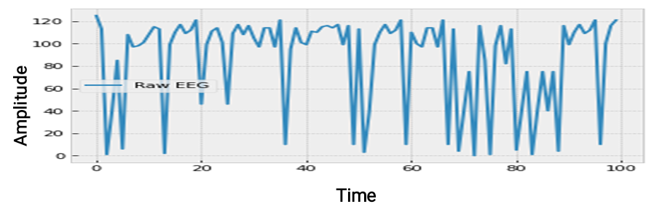
Visualization of DEAP Data

Slide 18
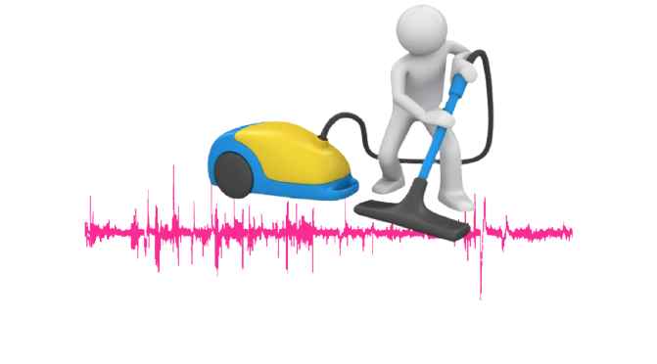
Preprocessing
Artifacts remove
EEG signals are downsampled to 128 Hz
A bandpass filter has been applied
Electromyogram (EMG) remove
Electrooculogram (EOG) remove

Slide 19
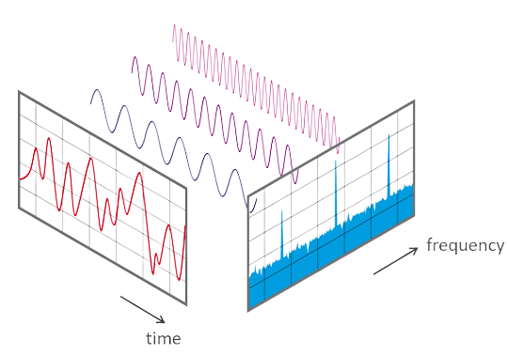
Feature Extraction
Time domain Feature → Frequency domain features with the help of Fast Fourier Transformation (FFT).
What is FFT?

Slide 20
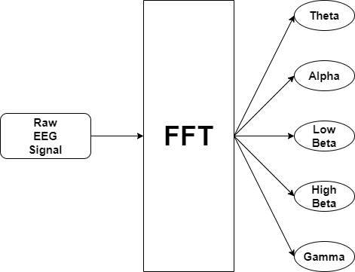
Signal Decomposition
(4-7) Hz
Window Size = 256
Sample Rate = 128
Step Size = 16
(8-12)Hz
(12.5–16)Hz
(16.5–30)Hz
>30 Hz

Slide 21
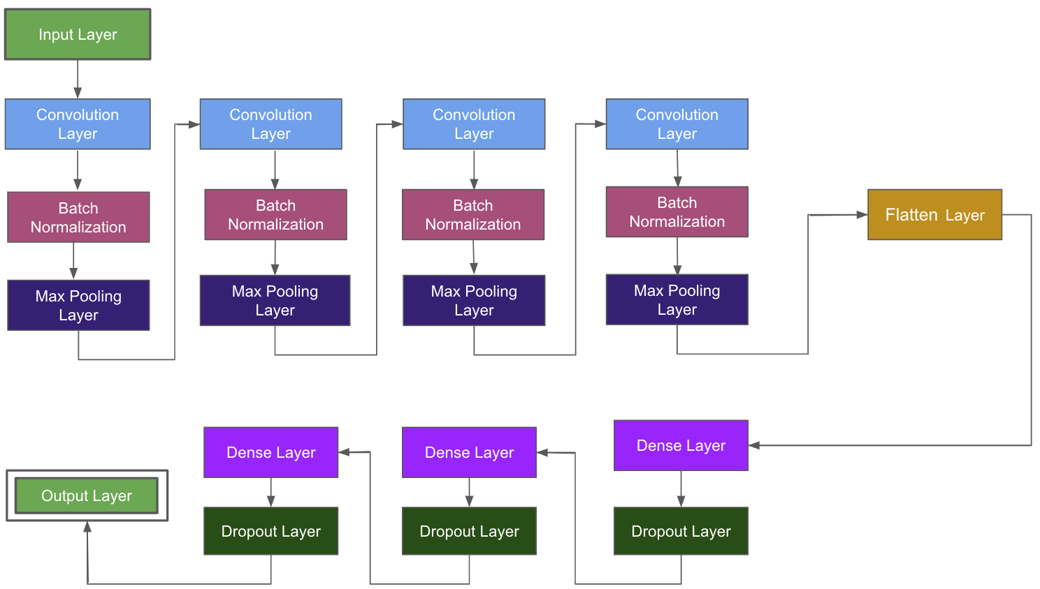
Proposed Model Architecture

Slide 22
Model Specification
Step: 1 | Convolutional layer: kernel size = 9, activation function = Relu
 | Batch Normalization
 | Pooling layer: MaxPooling1D, pool size = 2
Step: 2 | Convolutional layer: kernel size = 6, activation function = Relu
 | Batch Normalization
 | Pooling layer: MaxPooling1D, pool size = 2
Step: 3 | Convolutional layer: kernel size = 6, activation function = Relu
 | Batch Normalization
 | Pooling layer: MaxPooling1D, pool size = 2
Step: 4 | Convolutional layer: kernel size = 6, activation function = Relu
 | Batch Normalization
 | Pooling layer: MaxPooling1D, pool size = 2
Step: 5 | Flattening layer
Step:6 | Dense layer: Dense 1024 , activation function = Relu
 | Dropout 0.2
Step: 7 | Dense layer: Dense 256, activation function Relu
 | Dropout 0.2
Step: 8 | Dense layer: Dense 64, activation function= Relu
 | Dropout 0.2
Step: 9 | Final Dense Layer: Classes = 2/8, activation function = softmax
Optimizer | adam
Batch Size | 256
No. of Parameters | 4,952,394

Slide 23
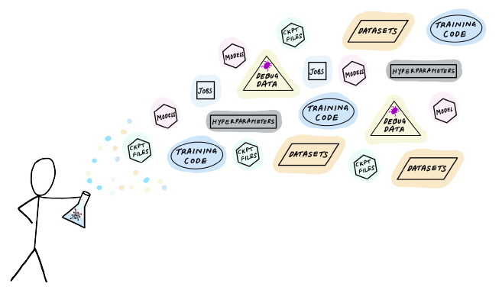
Design, Train, Tune and Test ML Models
Designed six 1D-CNN model
Trained with preprocessed DEAP dataset
Hyperparameter tuning to get the best accuracy
Test the models on unseen dataset

Slide 24
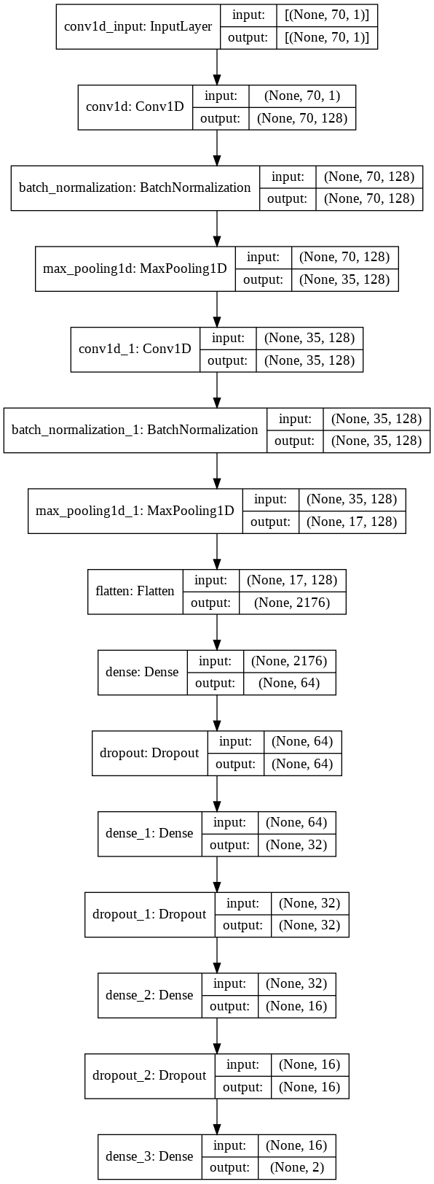
Model Architecture-1
Convolution Layer = 2 and Dense Layer = 2

Slide 25
Experiment-1
Window Size | Step Size | Sample Rate | Batch Size | Epoch | Train accuracy | Test accuracy
256 | 16 | 128 | 256 | 579 | 78.42% | 86.91%
512 | 16 | 128 | 256 | 498 | 77.89% | 80.81%
128 | 16 | 128 | 256 | 293 | 43.74% | 44.84%
256 | 32 | 128 | 256 | 553 | 58.82% | 57.69%
256 | 8 | 128 | 256 | 219 | 60.70% | 69.41%
256 | 16 | 256 | 256 | 308 | 44.58% | 46.58%
256 | 16 | 64 | 256 | 423 | 54.99% | 59.07%

Slide 26
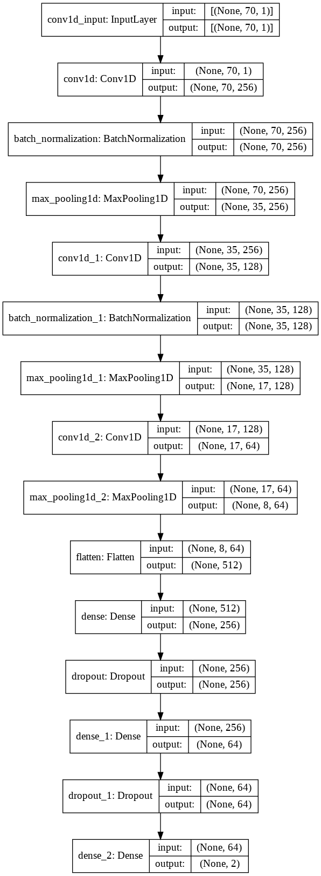
Model Architecture-2
Convolution Layer = 3 and Dense Layer = 2

Slide 27
Experiment-2
Window Size | Step Size | Sample Rate | Batch Size | Epoch | Train accuracy | Test accuracy
256 | 16 | 128 | 256 | 530 | 84.29% | 69.38%

Slide 28
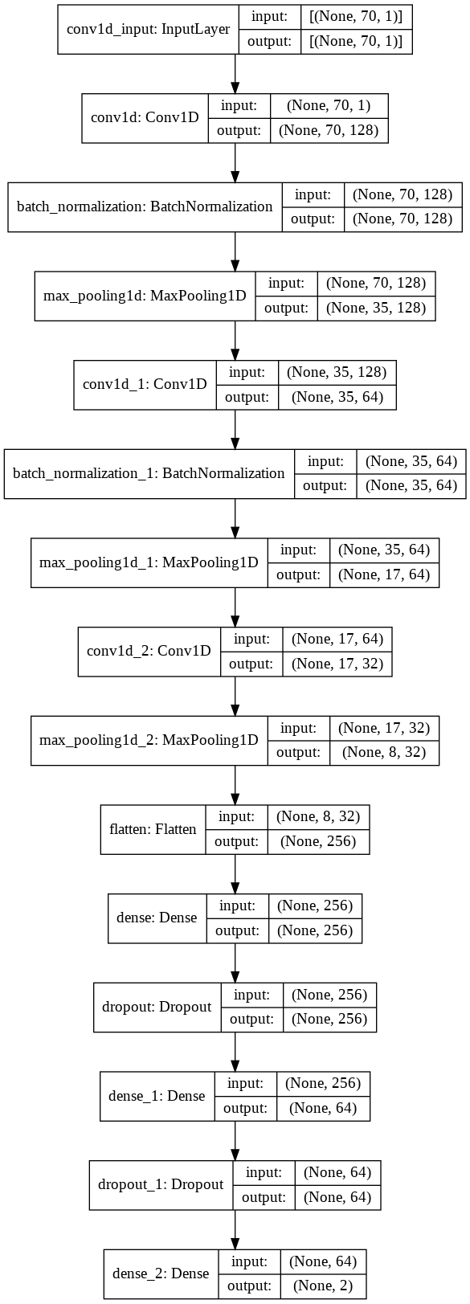
Model Architecture-3
Convolution Layer = 3 and Dense Layer = 2

Slide 29
Experiment-3
Window Size | Step Size | Sample Rate | Batch Size | Epoch | Train accuracy | Test accuracy
256 | 16 | 128 | 256 | 494 | 66.13% | 70.39%

Slide 30
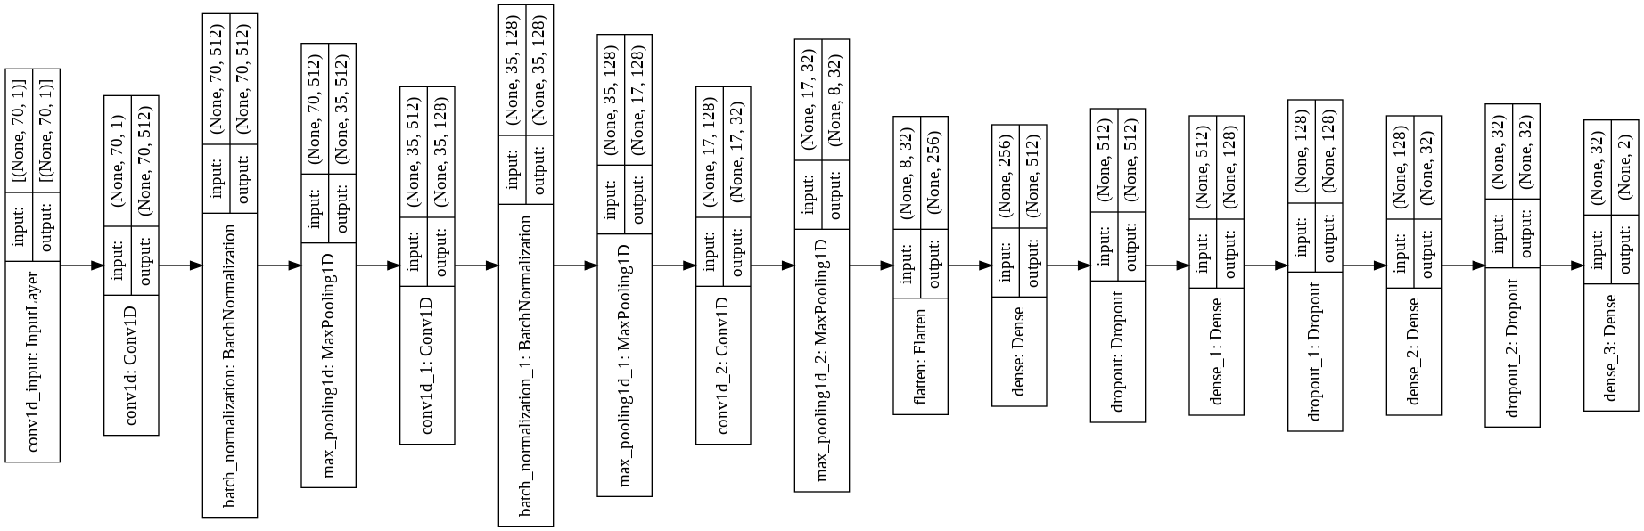
Model Architecture-4
Convolution Layer = 3 and Dense Layer = 3

Slide 31
Experiment-4
Window Size | Step Size | Sample Rate | Batch Size | Epoch | Train accuracy | Test accuracy
256 | 16 | 128 | 256 | 284 | 88.25% | 86.78%
256 | 16 | 128 | 128 | 350 | 88.96% | 72.93%
256 | 16 | 128 | 512 | 372 | 91.95% | 73.79%

Slide 32
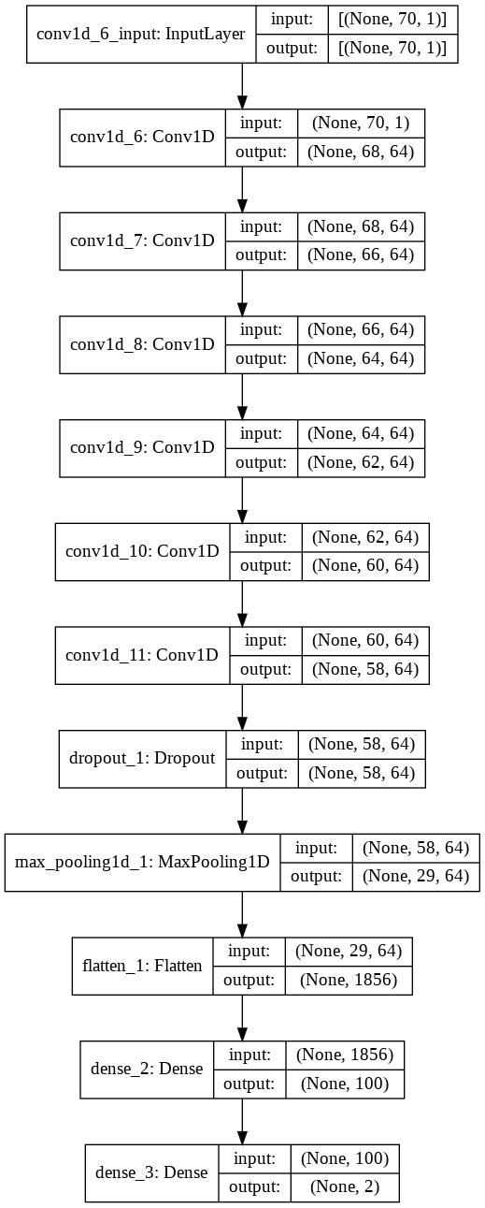
Model Architecture-5
Convolution Layer = 6 and Dense Layer = 1

Slide 33
Experiment-5
Window Size | Step Size | Sample Rate | Batch Size | Epoch | Train accuracy | Test accuracy
256 | 16 | 128 | 256 | 50 | 64.99% | 65.22%
256 | 16 | 128 | 512 | 100 | 64.77% | 65.05%
256 | 16 | 128 | 128 | 100 | 67.23% | 66.75%
512 | 16 | 128 | 256 | 100 | 65.90% | 66.00%
512 | 16 | 128 | 128 | 100 | 67.27% | 66.40%

Slide 34
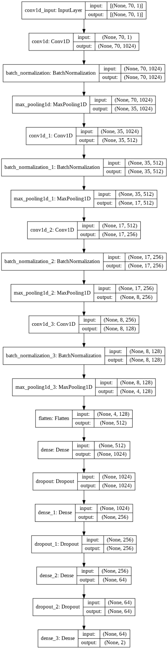
Model Architecture-6
Convolution Layer =4 and Dense Layer = 3

Slide 35
Experiment-6
Window Size | Step Size | Sample Rate | Batch Size | Epoch | Train accuracy | Test accuracy
256 | 16 | 128 | 256 | 319 | 99.36% | 94.02%

Slide 36
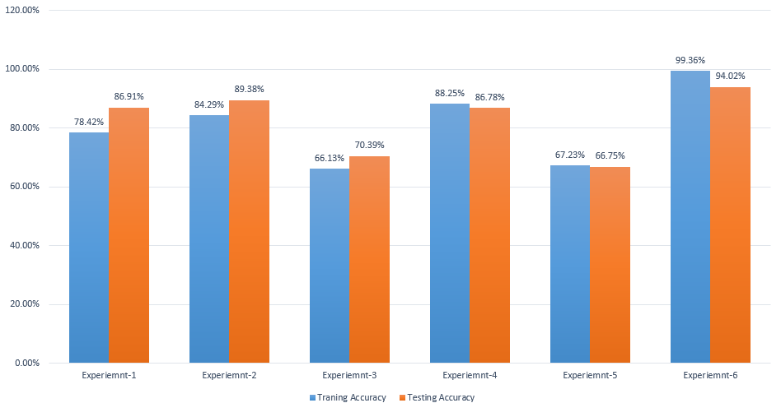
Experiment Summary Graph

Slide 37
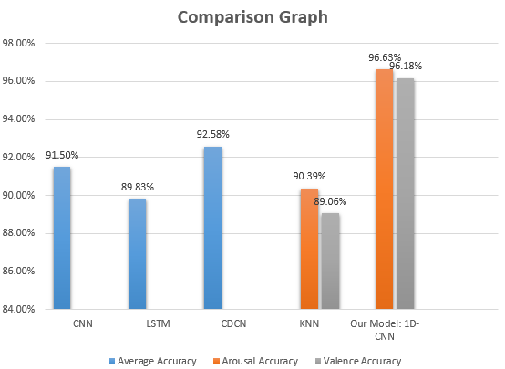
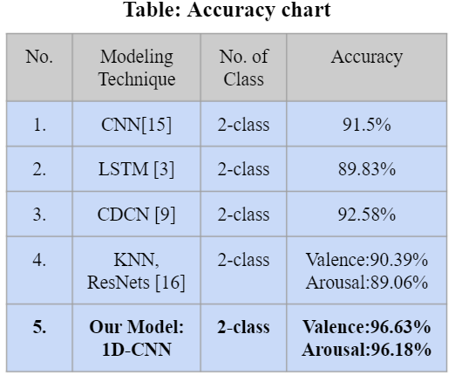
Binary-Class Result Analysis

Slide 38
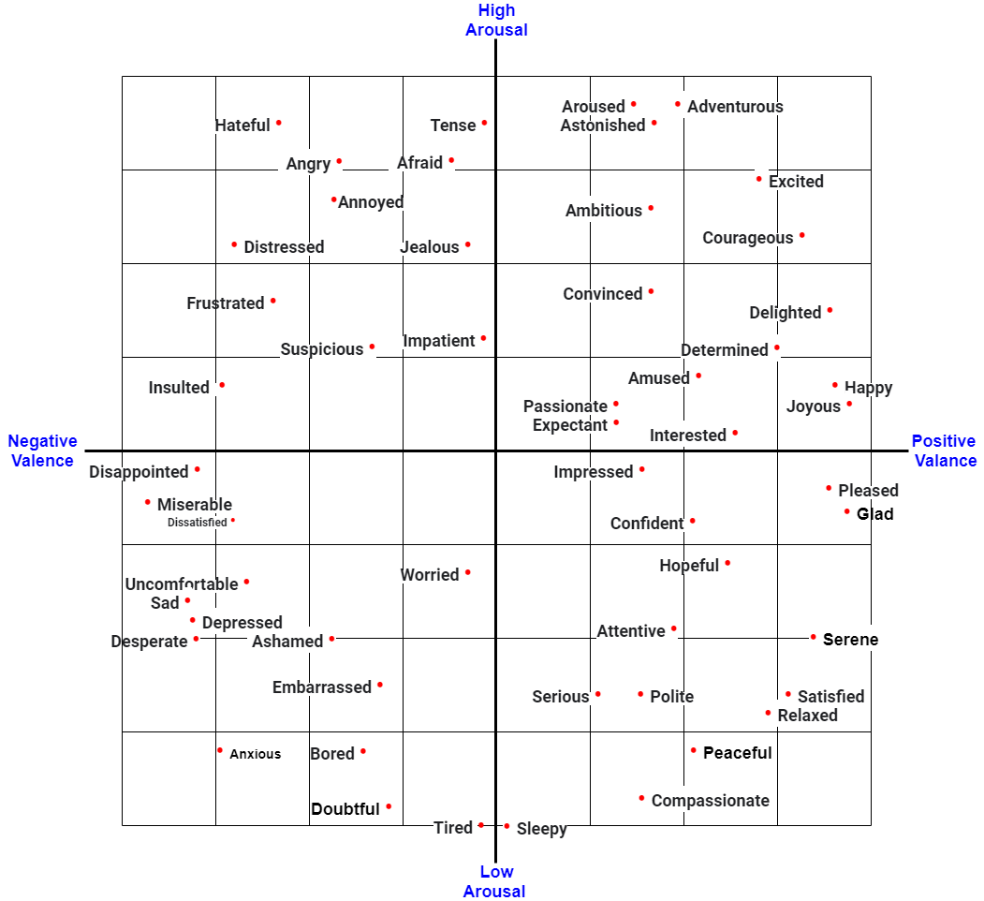
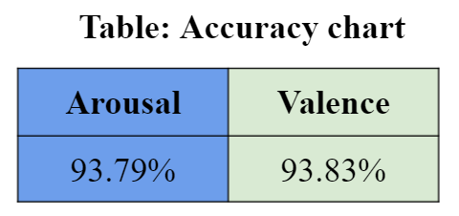
8-Class Result Analysis

Slide 39

Contribution
Highest accuracy for binary emotion classification.
 | Emotions | Classification Accuracy
State of the art model | 4 | Average: 92.5%
Our model | 64 | Arousal: 96.18% Valence: 96.63%
2. Proposed eight-class emotion classification method
which can recognize total of 64 emotions.

Slide 40
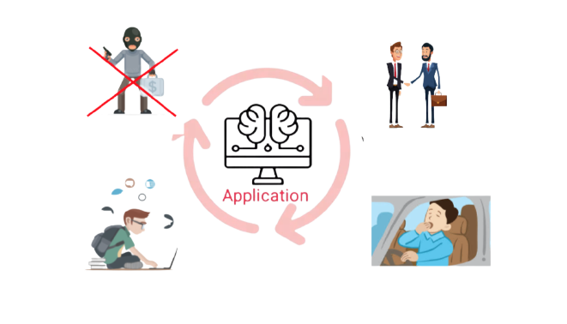
Application
1. Monitoring the psychological condition.
2. Determining fatigue while driving and advance warning.
3. Increasing security of ATMs users.
4. Developing teaching strategy according to the learner's mental feedback.
5. Lying detection from statements.

Slide 41

Future Plan
To convert it into a real-time system.
2. Try to make the model more portable.
3. Try to make our proposed 8 class classification more efficient.
4. Try to find out more efficient approach.

Slide 42
Appendix
Conference
(Under Review)
Github Link
5th International Conference on Imaging, Vision & Pattern Recognition (IVPR), Japan.
https://github.com/mahmudul-11/Undergraduate_Thesis_On_Emotion-Recogniton

Slide 43
References
Rayatdoost, Soheil, and Mohammad Soleymani. "Cross-corpus EEG-based emotion recognition." In 2018 IEEE 28th International Workshop on Machine Learning for Signal Processing (MLSP), pp. 1-6. IEEE, 2018.
Acharya, Divya, Shivani Goel, Rishi Asthana, and Arpit Bhardwaj. "A novel fitness function in genetic programming to handle unbalanced emotion recognition data." Pattern Recognition Letters 133 (2020): 272-279.
Acharya, Divya, Shivani Goel, Harshit Bhardwaj, Aditi Sakalle, and Arpit Bhardwaj. "A long short term memory deep learning network for the classification of negative emotions using EEG signals." In 2020 International Joint Conference on Neural Networks (IJCNN), pp. 1-8. IEEE, 2020.
Sharma, Rahul, Ram Bilas Pachori, and Pradip Sircar. "Automated emotion recognition based on higher order statistics and deep learning algorithm." Biomedical Signal Processing and Control 58 (2020): 101867.
Wang, Fei, Shichao Wu, Weiwei Zhang, Zongfeng Xu, Yahui Zhang, Chengdong Wu, and Sonya Coleman. "Emotion recognition with convolutional neural network and EEG-based EFDMs." Neuropsychologia 146 (2020): 107506.
Hassan, Reshad, Sakib Hasan, Md Jubaer Hasan, Md Rafat Jamader, David Eisenberg, and Tanmoy Pias. "Human Attention Recognition with Machine Learning from Brain-EEG Signals." In 2020 IEEE 2nd Eurasia Conference on Biomedical Engineering, Healthcare and Sustainability (ECBIOS), pp. 16-19. IEEE, 2020.
Nath, Debarshi, Mrigank Singh, Divyashikha Sethia, Diksha Kalra, and S. Indu. "An Efficient Approach to EEG-Based Emotion Recognition using LSTM Network." In 2020 16th IEEE International Colloquium on Signal Processing & Its Applications (CSPA), pp. 88-92. IEEE, 2020.
Cheah, Kit Hwa, Humaira Nisar, Vooi Voon Yap, and Chen-Yi Lee. "Short-time-span EEG-based personalized emotion recognition with deep convolutional neural network." In 2019 IEEE International Conference on Signal and Image Processing Applications (ICSIPA), pp. 78-83. IEEE, 2019.
Gao, Zhongke, Xinmin Wang, Yuxuan Yang, Yanli Li, Kai Ma, and Guanrong Chen. "A channel-fused dense convolutional network for EEG-based emotion recognition." IEEE Transactions on Cognitive and Developmental Systems (2020).
Luo, Yuling, Qiang Fu, Juntao Xie, Yunbai Qin, Guopei Wu, Junxiu Liu, Frank Jiang, Yi Cao, and Xuemei Ding. "EEG-based emotion classification using spiking neural networks." IEEE Access 8 (2020): 46007-46016.
Cimtay, Yucel, and Erhan Ekmekcioglu. "Investigating the use of pretrained convolutional neural network on cross-subject and cross-dataset EEG emotion recognition." Sensors 20, no. 7 (2020): 2034.
Cao, Guolu, Yuliang Ma, Xiaofei Meng, Yunyuan Gao, and Ming Meng. "Emotion recognition based on CNN." In 2019 Chinese Control Conference (CCC), pp. 8627-8630. IEEE, 2019.
Abdel-Ghaffar, Eman A., and Mohamed Daoudi. "Emotion Recognition from Multidimensional Electroencephalographic Signals on the Manifold of Symmetric Positive Definite Matrices." In 2020 IEEE Conference on Multimedia Information Processing and Retrieval (MIPR), pp. 354-359. IEEE, 2020.
Zhong, Xiaolong, Zhong Yin, and Jianhua Zhang. "Cross-Subject emotion recognition from EEG using Convolutional Neural Networks." In 2020 39th Chinese Control Conference (CCC), pp. 7516-7521. IEEE, 2020.
Cimtay, Yucel, Erhan Ekmekcioglu, and Seyma Caglar-Ozhan. "Cross-subject multimodal emotion recognition based on hybrid fusion." IEEE Access 8 (2020): 168865-168878.
Liu, Ningjie, Yuchun Fang, Ling Li, Limin Hou, Fenglei Yang, and Yike Guo. "Multiple feature fusion for automatic emotion recognition using EEG signals." In 2018 IEEE International Conference on Acoustics, Speech and Signal Processing (ICASSP), pp. 896-900. IEEE, 2018.
Koelstra, Sander, Christian Muhl, Mohammad Soleymani, Jong-Seok Lee, Ashkan Yazdani, Touradj Ebrahimi, Thierry Pun, Anton Nijholt, and Ioannis Patras. "Deap: A database for emotion analysis; using physiological signals." IEEE transactions on affective computing 3, no. 1 (2011): 18-31.
Yoon, Hyun Joong, and Seong Youb Chung. "EEG-based emotion estimation using Bayesian weighted-log-posterior function and perceptron convergence algorithm." Computers in biology and medicine 43, no. 12 (2013): 2230-2237.
Rozgić, Viktor, Shiv N. Vitaladevuni, and Rohit Prasad. "Robust EEG emotion classification using segment level decision fusion." In 2013 IEEE international conference on acoustics, speech and signal processing, pp. 1286-1290. IEEE, 2013.
Zhang, Xiaowei, Bin Hu, Jing Chen, and Philip Moore. "Ontology-based context modeling for emotion recognition in an intelligent web." World Wide Web 16, no. 4 (2013): 497-513.
Li, Xiang, Dawei Song, Peng Zhang, Guangliang Yu, Yuexian Hou, and Bin Hu. "Emotion recognition from multi-channel EEG data through convolutional recurrent neural network." In 2016 IEEE international conference on bioinformatics and biomedicine (BIBM), pp. 352-359. IEEE, 2016.
Al-Nafjan, Abeer, Manar Hosny, Areej Al-Wabil, and Yousef Al-Ohali. "Classification of human emotions from electroencephalogram (EEG) signal using deep neural network." Int. J. Adv. Comput. Sci. Appl 8, no. 9 (2017): 419-425.
Liu, Wei, Wei-Long Zheng, and Bao-Liang Lu. "Emotion recognition using multimodal deep learning." In International conference on neural information processing, pp. 521-529. Springer, Cham, 2016.
Tripathi, Samarth, Shrinivas Acharya, Ranti Dev Sharma, Sudhanshi Mittal, and Samit Bhattacharya. "Using deep and convolutional neural networks for accurate emotion classification on DEAP dataset." In Proceedings of the Thirty-First AAAI Conference on Artificial Intelligence, pp. 4746-4752. 2017.
Zheng, Wei-Long, Jia-Yi Zhu, and Bao-Liang Lu. "Identifying stable patterns over time for emotion recognition from EEG." IEEE Transactions on Affective Computing 10, no. 3 (2017): 417-429.
Horlings, Robert, Dragos Datcu, and Leon JM Rothkrantz. "Emotion recognition using brain activity." In Proceedings of the 9th international conference on computer systems and technologies and workshop for PhD students in computing, pp. II-1. 2008.
Mühl, Christian, Brendan Allison, Anton Nijholt, and Guillaume Chanel. "A survey of affective brain computer interfaces: principles, state-of-the-art, and challenges." Brain-Computer Interfaces 1, no. 2 (2014): 66-84.
The Science of Brainwaves – the Language of the Brain, [Accessed: 03- Jun- 2021], 2021. [Online]. Available: https://nhahealth.com/brainwaves-the-language/
Matlovic, Tomas, Peter Gaspar, Robert Moro, Jakub Simko, and Maria Bielikova. "Emotions detection using facial expressions recognition and EEG." In 2016 11th international workshop on semantic and social media adaptation and personalization (SMAP), pp. 18-23. IEEE, 2016.
Electroencephalography, [Accessed: 03-Jun-2021], 2021. [Online]. Available:https://en.wikipedia.org/wiki/Electroencephalography
Brain Anatomy and How the Brain Works, [Accessed: 03- Jun- 2021], 2021. [Online]. Available:https://www.hopkinsmedicine.org/health/conditions-and-diseases/anatomy-of-the-brain
Right Hand, Human Brain, [Accessed: 03-Jun-2021], 2021. [Online]. Available: https://benjaminckinney.com/right-hand-human-brain/
Nagel, Sebastian. "Towards a home-use BCI: fast asynchronous control and robust non-control state detection." PhD diss., Eberhard Karls Universität Tübingen, 2019.

Slide 44

Is there any Questions?

